Slide 1
Sequence Diagram

Slide 2
Sequence Diagrams
A sequence diagram is a type of interaction diagram because it describes how—and in what order—a group of objects works together.
These diagrams are used by software developers and business professionals to understand requirements for a new system or to document an existing process.
Sequence diagrams are sometimes known as event diagrams or event scenarios.
Sequence Diagrams are time focus and they show the order of the interaction visually by using the vertical axis of the diagram to represent time what messages are sent and when

Slide 3
Basic Symbols and Components

Slide 4
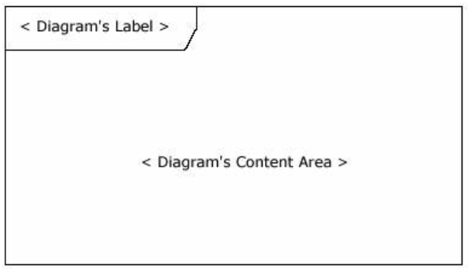
Frame
A frame element provides a consistent place for a diagram's label, while providing a graphical boundary for the diagram. The frame element is optional in UML diagrams

Slide 5
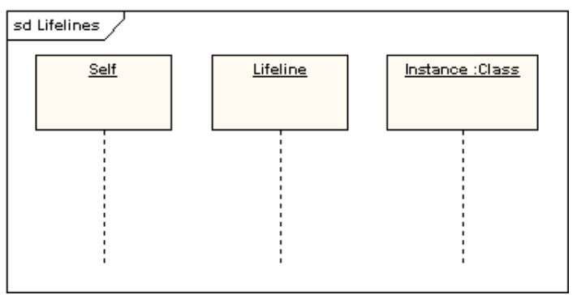
Lifeline
A lifeline represents an individual participant in a sequence diagram.
A lifeline will usually have a rectangle containing its object name.
If its name is "self", that indicates that the lifeline represents the classifier which owns the sequence diagram

Slide 6
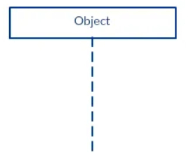

Lifeline
A lifeline represents an individual participant in the Interaction.
A sequence diagram is made up of several of these lifeline notations that should be arranged horizontally across the top of the diagram.
No two lifeline notations should overlap each other. They represent the different objects or parts that interact with each other in the system during the sequence.
A lifeline notation with an actor element symbol is used when the particular sequence diagram is owned by a use case.

Slide 7
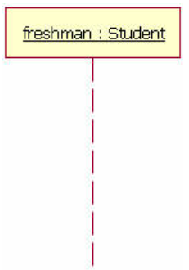
Lifeline
Lifelines represent either roles or object instances that participate in the sequence being modeled.
In the example shown in Figure, the lifeline represents an instance of the class Student, whose instance name is freshman. Note that, here, the lifeline name is underlined. When an underline is used, it means that the lifeline represents a specific instance of a class in a sequence diagram, and not a particular kind of instance (i.e., a role).
Sequence diagrams may include roles (such as buyer and seller) without specifying who plays those roles (such as Bill and Fred). This allows diagram reuse in different contexts. Simply put, instance names in sequence diagrams are underlined; roles names are not.

Slide 8
Lifeline
Our example lifeline in Figure is a named object, but not all lifelines represent named objects. Instead a lifeline can be used to represent an anonymous or unnamed instance.
When modeling an unnamed instance on a sequence diagram, the lifeline's name follows the same pattern as a named instance; but instead of providing an instance name, that portion of the lifeline's name is left blank.
Again referring to Figure, if the lifeline is representing an anonymous instance of the Student class, the lifeline would be: "Student." Also, because sequence diagrams are used during the design phase of projects, it is completely legitimate to have an object whose type is unspecified: for example, "freshman."

Slide 9

Actor
a type of role played by an entity that interacts with the subject (e.g., by exchanging signals and data)
external to the subject (i.e., in the sense that an instance of an actor is not a part of the instance of its corresponding subject).
represent roles played by human users, external hardware, or other subjects.
An actor does not necessarily represent a specific physical entity but merely a particular role of some entity.
A person may play the role of several different actors and, conversely, a given actor may be played by multiple different person.

Slide 10
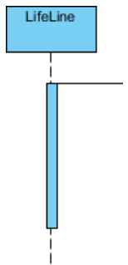
Activations
A thin rectangle on a lifeline) represents the period during which an element is performing an operation.
The top and the bottom of the of the rectangle are aligned with the initiation and the completion time respectively.
Some people also called it Execution Occurrence or Activation Bars.
It is used to indicate that an object is active (or instantiated) during an interaction between two objects. The length of the rectangle indicates the duration of the objects staying active.
In a sequence diagram, an interaction between two objects occurs when one object sends a message to another.
The use of the activation bar on the lifelines of the Message Caller (the object that sends the message) and the Message Receiver (the object that receives the message) indicates that both are active/ are instantiated during the exchange of the message.

Slide 11
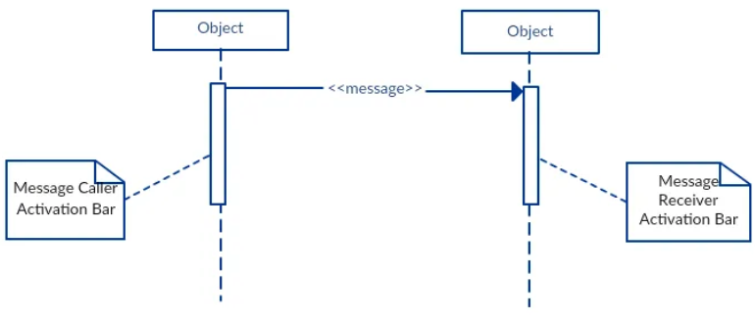

Slide 12
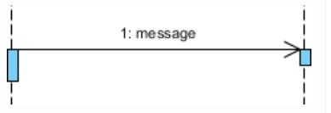
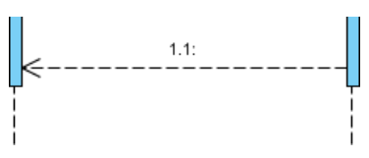
Call Message
A message defines a particular communication between Lifelines of an Interaction.
Call message is a kind of message that represents an invocation of operation of target lifeline
Return Message
A message defines a particular communication between Lifelines of an Interaction.
Return message is a kind of message that represents the pass of information back to the caller of a corresponded former message

Slide 13
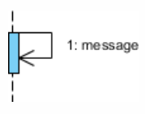
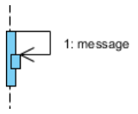
Self Message
Self message is a kind of message that represents
the invocation of message of the same lifeline.
In it one method calling another method belonging to the same object.
Recursive Message
Recursive message is a kind of message that
represents the invocation of message of the
same lifeline. It's target points to an activation
on top of the activation where the message was
invoked from.
It represent a recursive call of an operation

Slide 14
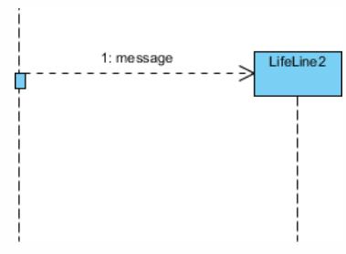
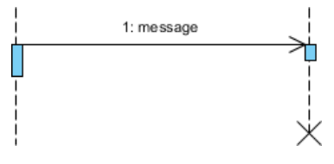
Create Message
A message defines a particular communication
between Lifelines of an Interaction.
Create message is a kind of message
that represents the instantiation of (target) lifeline.
Destroy Message
A message defines a particular communication
between Lifelines of an Interaction.
Destroy message is a kind of message that represents the request of destroying the lifecycle of target lifeline..

Slide 15
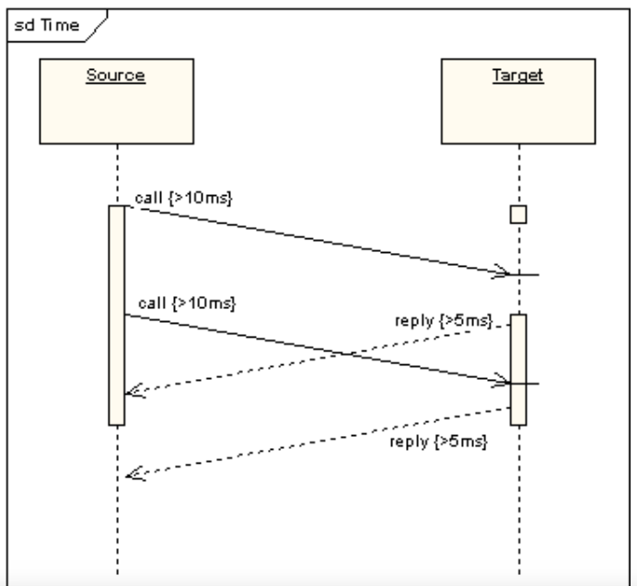

Duration Message
Duration message shows the distance
between two time instants for a message
invocation.
By setting a duration constraint for a
message, the message will be shown as
a sloping line
Note
A note (comment) gives the ability to attach various remarks to elements. A comment carries no semantic force, but may contain information that is useful to a modeler.

Slide 16
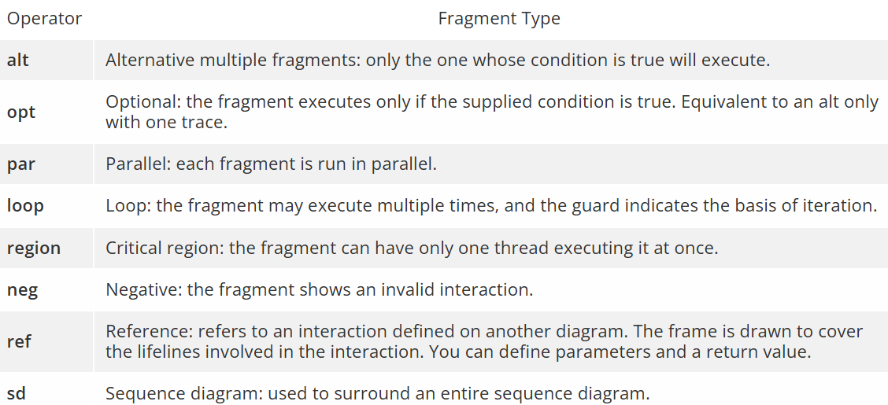

Slide 17
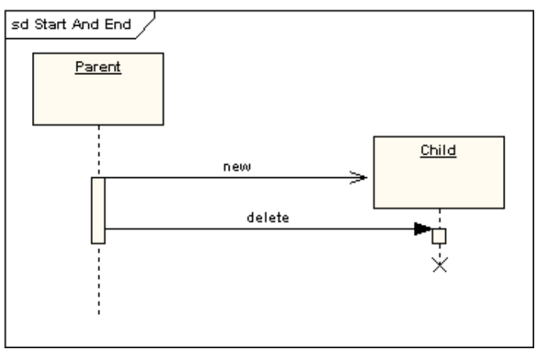
Lifeline Start and End
The following diagram shows an object being created and destroyed.

Slide 18
Message
The first message of a sequence diagram always starts at the top and is typically located on the left side of the diagram for readability.
Subsequent messages are then added to the diagram slightly lower then the previous message.
To show an object (i.e., lifeline) sending a message to another object, you draw a line to the receiving object with a solid arrowhead (if a synchronous call operation) or with a stick arrowhead (if an asynchronous signal).
The message/method name is placed above the arrowed line. The message that is being sent to the receiving object represents an operation/method that the receiving object's class implements.

Slide 19
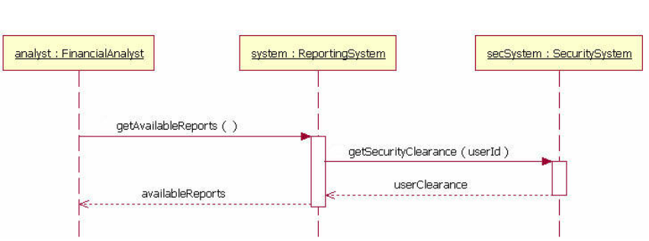
Message

Slide 20
Message
In the example in Figure 4, the analyst object makes a call to the system object which is an instance of the ReportingSystem class.
The analyst object is calling the system object's getAvailableReports method.
The system object then calls the getSecurityClearance method with the argument of userId on the secSystem object, which is of the class type SecuritySystem.
(Note: When reading this sequence diagram, assume that the analyst has already logged into the system.

Slide 21
Message
Besides just showing message calls on the sequence diagram, the Figure diagram includes return messages.
These return messages are optional; a return message is drawn as a dotted line with an open arrowhead back to the originating lifeline, and above this dotted line you place the return value from the operation.
In Figure the secSystem object returns userClearance to the system object when the getSecurityClearance method is called. The system object returns availableReports when the getAvailableReports method is called.
Again, the return messages are an optional part of a sequence diagram. The use of return messages depends on the level of detail/abstraction that is being modeled. Return messages are useful if finer detail is required; otherwise, the invocation message is sufficient. I personally like to include return messages whenever a value will be returned, because I find the extra details make a sequence diagram easier to read

Slide 22
Message
When modeling a sequence diagram, there will be times that an object will need to send a message to itself. When does an object call itself? A purist would argue that an object should never send a message to itself. However, modeling an object sending a message to itself can be useful in some cases. For example, Figure on next slide is an improved version of the last given Figure. The new Figure shows the system object calling its determineAvailableReports method. By showing the system sending itself the message "determineAvailableReports," the model draws attention to the fact that this processing takes place in the system object.
To draw an object calling itself, you draw a message as you would normally, but instead of connecting it to another object, you connect the message back to the object itself.

Slide 23
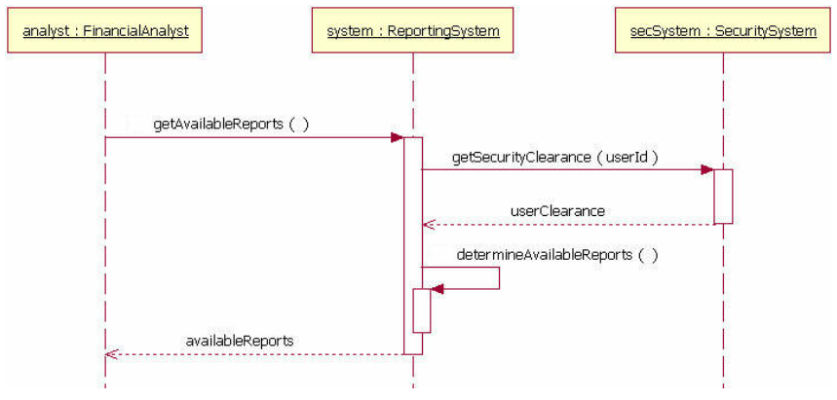
Message

Slide 24
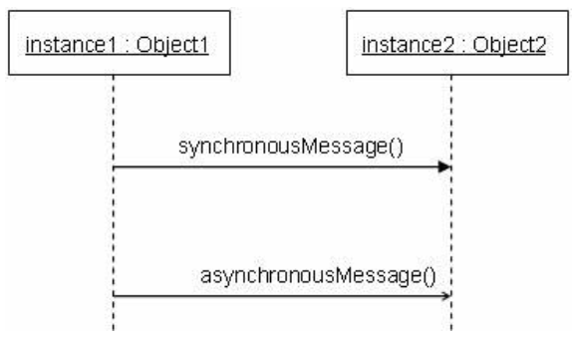
Message
The example messages in last Figure show synchronous messages; however, in sequence diagrams you can model asynchronous messages, too. An asynchronous message is drawn similar to a synchronous one, but the message's line is drawn with a stick arrowhead, as shown in Figure below.

Slide 25
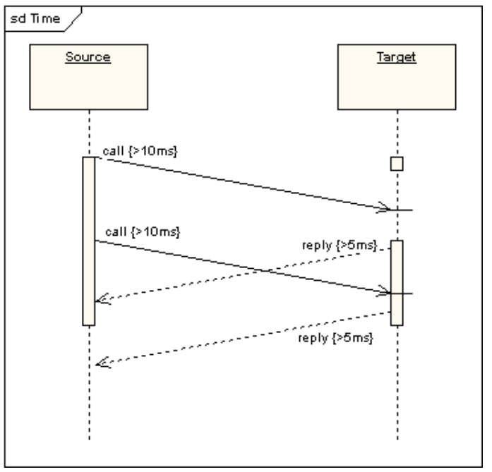
Duration and Time Constraints
By default, a message is shown as a horizontal line. Since the lifeline represents the passage of time down the screen, when modelling a real-time system, or even a time-bound business process, it can be important to consider the length of time it takes to perform actions. By setting a duration constraint for a message, the message will be shown as a sloping line.

Slide 26
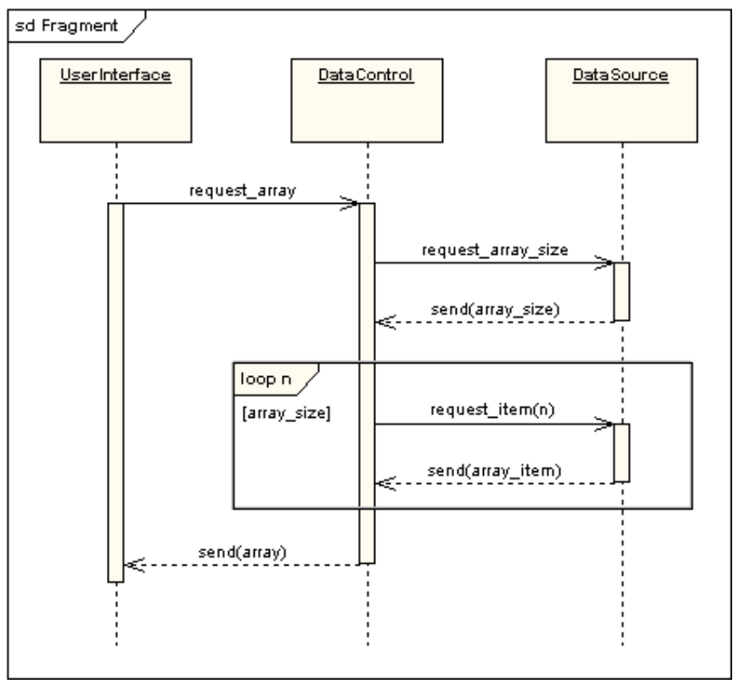
The following diagram shows a loop fragment

Slide 27
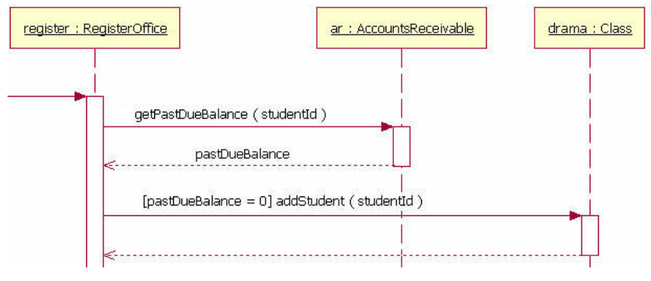
Guards
When modeling object interactions, there will be times when a condition must be met for a message to be sent to the object.
Guards are used throughout UML diagrams to control flow. Figure shows a fragment of a sequence diagram with a guard on the message addStudent method.
The guard is the text "[pastDueBalance = 0]." By having the guard on this message, the addStudent message will only be sent if the accounts receivable system returns a past due balance of zero.

Slide 28
How to make a sequence diagram

Slide 29
Step 1: Identify the scenario
Start by defining the scenario you want to depict in the diagram. Is it a user logging in, placing an order, or browsing a product catalog?
Step 2: Identify the objects and actors involved
The objects and actors represent anything interacting and exchanging information during the scenario. For example, if your scenario is someone ordering a pizza online, components that may be involved include:
Actor: user (the person placing the order).
Object 1: web browser (where the user interacts with the online pizza shop).
Object 2: order processing system (internal system that handles the order).
Object 3: database (stores information about pizzas, user details, etc.).
Place all the components, including actors and objects, horizontally across the top of the diagram. Each component represents a lifeline, showing its involvement throughout the scenario.

Slide 30
Step 3: Draw the message flow
Use arrows to represent messages exchanged between components. To show the sequence of messages, place arrows and activation bars (which highlight when a component is active) appropriately.
Consider this important distinction when drawing message flow:
Synchronous messages (solid arrows). These messages imply the sender waits for a response from the receiver before continuing. Think of it like a conversation where you wait for a reply before speaking again.
Asynchronous messages (dashed arrows). These messages indicate the sender doesn’t wait for a response and can continue with other tasks. Imagine sending a text message and doing other things while waiting for a reply.

Slide 31
Step 4. Refine and document
Double-check the flow of messages and ensure they align with the scenario you defined. Are there any missing steps or inconsistencies? If you made any assumptions while creating the diagram, document them for future reference.
Sequence diagrams are excellent communication tools. Share your diagram with team members to ensure everyone is aligned on the interaction flow.

Slide 32
Sequence diagram examples

Slide 33
Logging into a system
Imagine a user entering their username and password to access Gmail.
In this example, the sequence diagram shows how the user interface interacts with the authentication server (checking credentials) and the database (fetching user information). Visualizing these interactions allows developers to:
Confirm correct information flow. Is the username and password securely sent to the authentication server?
Handle errors. How does the system handle incorrect passwords or server overloads?
Provide a smooth user experience. Is the user redirected to the inbox quickly after a successful login?
This allows developers to refine the login process before coding begins, leading to a smoother and more secure user experience.

Slide 34
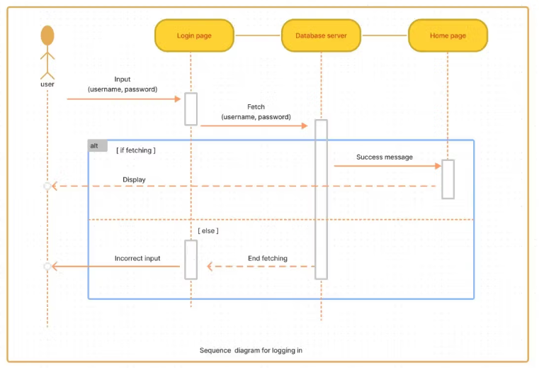

Slide 35
Placing an order
Sequence diagrams can help visualize the process of placing an order online, like on Amazon. Imagine a user adding an item to their cart and proceeding to checkout. The sequence diagram shows how the user interface interacts with the order processing system, which might look like this:
The system checks the shopping cart for items.
It verifies item availability in the product database.
It communicates with the payment gateway to process payment information.
By visualizing these interactions, developers can identify potential issues early:
Are steps missing, like confirming order details before payment?
What happens if the item is out of stock after being added to the cart?
How does the system handle potential payment gateway errors?
Using a sequence diagram ensures an efficient order placement process for users of an e-commerce website.

Slide 36
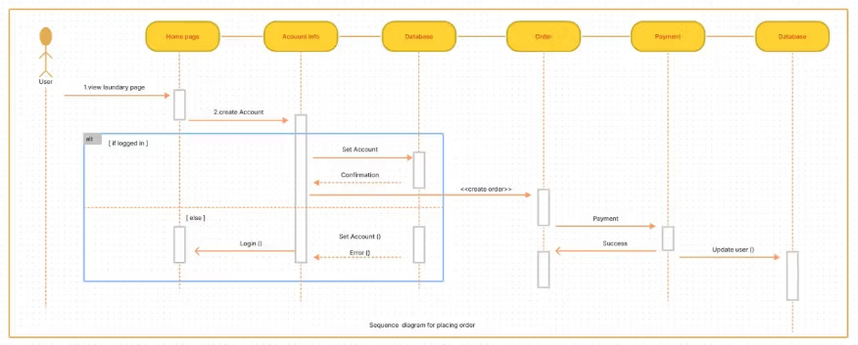

Slide 37
Logging into a system
Imagine a user entering their username and password to access Gmail.
In this example, the sequence diagram shows how the user interface interacts with the authentication server (checking credentials) and the database (fetching user information). Visualizing these interactions allows developers to:
Confirm correct information flow. Is the username and password securely sent to the authentication server?
Handle errors. How does the system handle incorrect passwords or server overloads?
Provide a smooth user experience. Is the user redirected to the inbox quickly after a successful login?
This allows developers to refine the login process before coding begins, leading to a smoother and more secure user experience.

